Slide 1

Presented By :- Amarnath Kommineni Kavya Gurram Sandeep Borwal Vikas Kumar Reddy Buchammagari
Predicting Housing Market Trends: A Data-Driven Approach to Price Forecasting
Course :- DSCI8950 Presented To:- Lochana Palayangoda

Slide 2
Amarnath Kommineni
Education & Experience:
Currently pursuing a Master’s in Data Science. I hold a Master’s in Computer Applications (2004) and have over 20 years of experience in the IT industry.
Current Role:
I work as a Solution Lead at Mutual of Omaha, specializing in the insurance domain. My expertise includes:
Designing solutions for Actuarial Datamart
Designing and building solutions using ETL tools like Informatica
Building Datamarts on Teradata and Snowflake
Passionate about learning new technologies and currently exploring machine learning tools.
Hobbies:
My favorite pastime is to play Tennis / Fitness Center.
Personal Life:
Proud father of two wonderful kids who keep me busy!

Slide 3
Kavya Gurram
Hello! I'm Kavya Gurram
Educational Journey:
From India to the U.S. to pursue a Master's in Data Science at the University of Nebraska at Omaha.
Professional Background:
Former Front End Developer at Tata Consultancy Services, specializing in web applications.
Current Role:
Assisting as an IT Support Student Worker at UNO, focusing on tech issues and data management.
Internship: Currently interning with Emerging Ladies Academy (ELA), enhancing my practical experience.
Hobbies:
Passionate about art and henna, and I love keeping things organized

Slide 4
Sandeep Borwal
Hello! I'm Sandeep Borwal, a passionate and fun-loving professional.
Currently pursuing a Master’s in Data Science, I hold a Master’s in Computer Applications (2006) degree and have been part of the IT industry for over 19 years.
I work as a Senior Data Engineer at Mutual of Omaha, specializing in the insurance domain. My expertise includes Data Warehousing, AWS Cloud, Snowflake, Big Data & PySpark, Machine Learning (currently exploring).
I love playing cricket and basket ball and going for a walk in summers.
Proud father of two wonderful kids who keep me busy!

Slide 5
Vikas Kumar Reddy Buchammagari
Introduction
Education & Experience:
Currently pursuing a Master’s in Data Science. I hold a Bachelor’s degree and have 1.5 years of experience as a Data Analyst at KPIT Technologies.
Currently:
As a Master’s student, I am:
- Deepening my knowledge in machine learning, statistics, and big data technologies
- Working on projects involving data analysis, predictive modeling, and data visualization
- Gaining hands-on experience with tools like Python, R, SQL, and Tableau
Hobbies:
I enjoy outdoor activities, especially hiking, which keeps me active and connected with nature.

Slide 6
Predicting Housing Prices Using Machine Learning
Introduction
The real estate market significantly impacts the global economy.
Housing prices depend on multiple factors like location, size, and market trends.
Traditional pricing methods are subjective, time-consuming, and prone to errors.
Problem Statement
Estimating property values accurately remains a challenge.
Various factors, including property features and external conditions, influence prices.
Current appraisal methods lack efficiency and objectivity.
Solution: Machine Learning Model
Leverages historical data to identify patterns and correlations.
Improves accuracy by reducing human bias in price estimation.
Provides quick, data-driven predictions based on market conditions.
Project Goal
Develop a machine learning model to predict housing prices.
Use key property attributes and economic indicators for training.
Enhance reliability and efficiency in real estate pricing.

Slide 7
Understanding the Challenge in Housing Price Prediction
Defining the Problem:
Housing prices are influenced by multiple factors like location, size, market conditions, and amenities.
Traditional valuation methods rely on expert judgment, which can be subjective and inconsistent.
Challenges in Predicting Housing Prices:
Data Complexity: Numerous factors influence property values.
Market Volatility: Rapid economic changes affect prices.
Inefficiencies in Traditional Methods: Manual appraisals can be slow and error-prone.
How Machine Learning Can Help:
Automates analysis of large-scale data.
Identifies complex relationships among variables.
Provides objective, data-driven insights for real estate stakeholders.

Slide 8
Why Does This Problem Matter?
Importance of Real Estate Market in the Economy:
Housing market trends affect individuals, businesses, and financial institutions.
Real estate transactions contribute significantly to GDP.
Who Benefits from Accurate Predictions?
Homebuyers & Sellers: Better pricing and investment decisions.
Investors & Real Estate Agents: Identifying undervalued or high-potential properties.
Banks & Lenders: Assessing mortgage risks and setting interest rates.
Role of Machine Learning in Addressing the Problem:
Faster & more scalable than traditional valuation methods.
Helps reduce price fluctuations and increase market transparency

Slide 9
Project Objectives - What Are We Trying to Achieve?
Key SMART Objectives:
Data Collection & Cleaning: Gather structured and unstructured property data.
Exploratory Data Analysis (EDA): Identify trends and correlations.
Model Development: Train various ML models (regression, ensemble methods, deep learning).
Model Evaluation & Optimization: Use RMSE, MAE, and R-squared to assess accuracy.
Feature Importance Analysis: Identify key variables impacting property prices

Slide 10
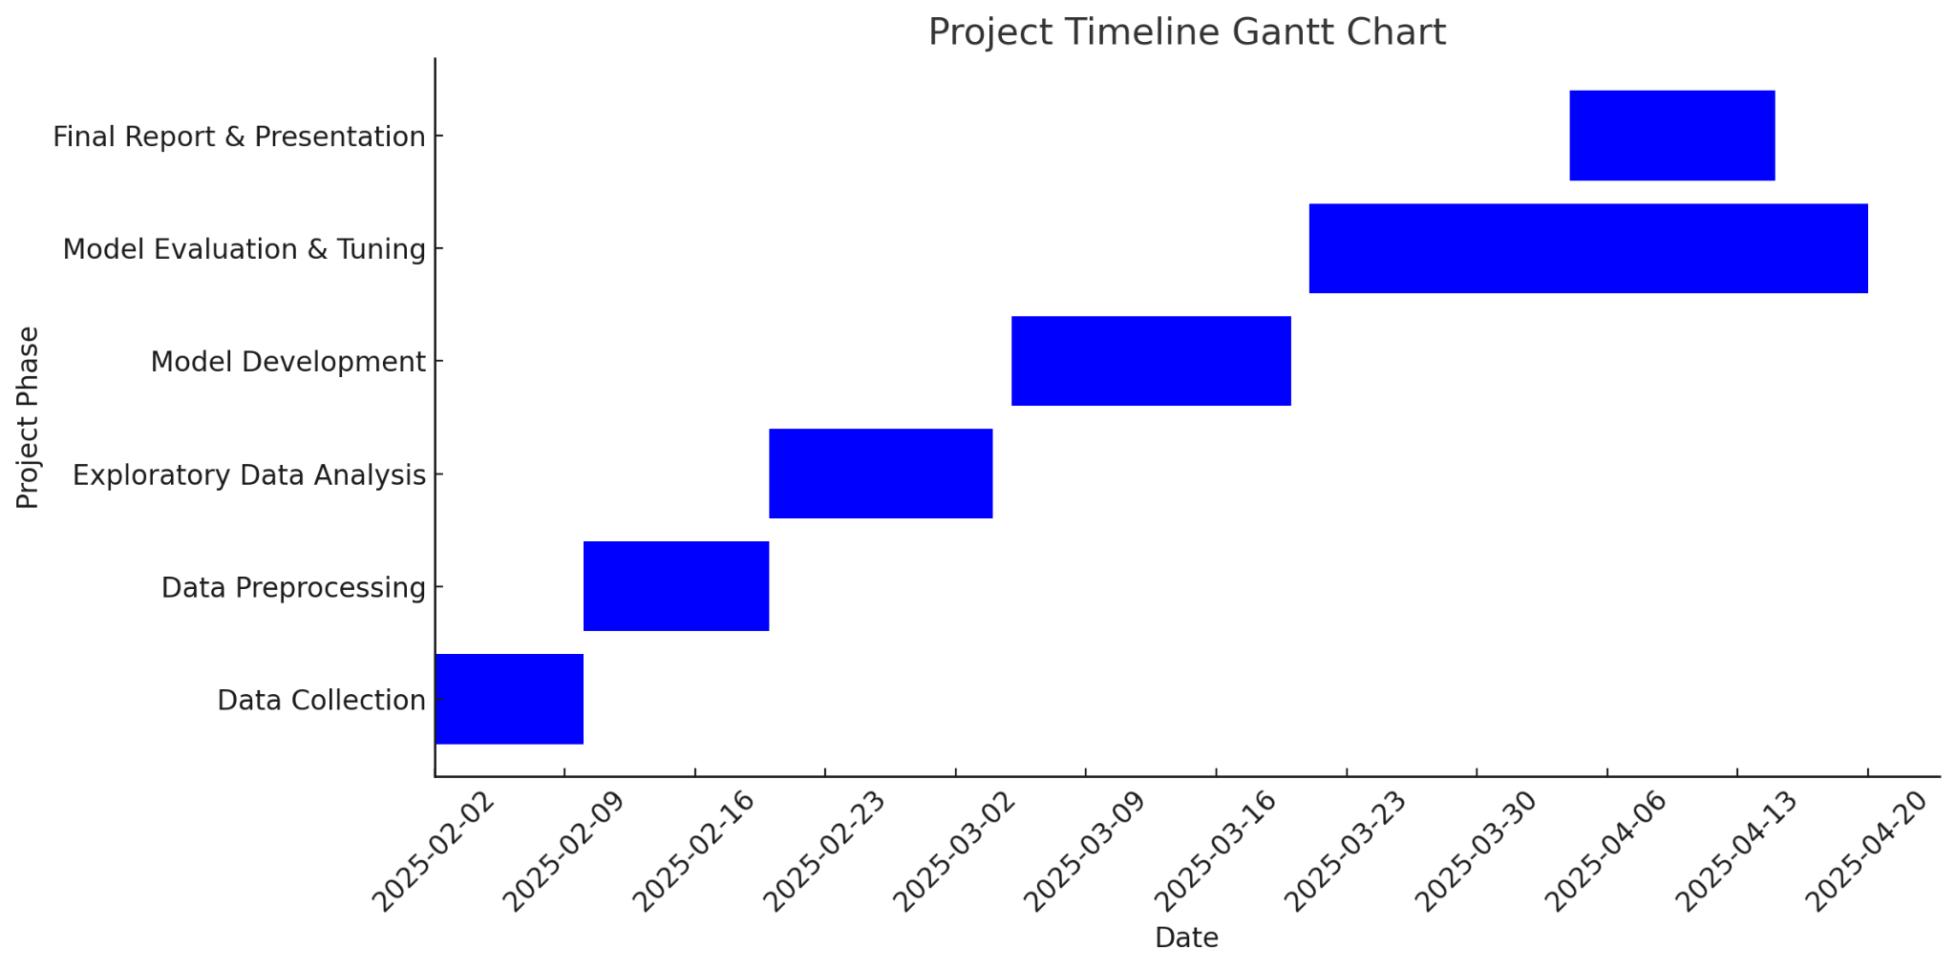
Project Roadmap & Milestones
Phase​ | Timeline​ | Key Activities​
Data Collection​ | Feb 1 - Feb 10​ | Gather property & economic data from Zillow, BEA, etc.​
Data Preprocessing​ | Feb 10 - Feb 20​ | Clean, preprocess, and handle missing values.​
Exploratory Data Analysis​ | Feb 20 - Mar 04​ | Data visualization, identifying key trends.​
Model Development​ | Mar 5 - Mar 20​ | Train multiple ML models and optimize performance.​
Model Evaluation & Tuning​ | Mar 21 - Apr 20​ | Compare results using evaluation metrics.​
Final Report & Presentation​ | Apr 15 – Apr 30​ | Summarize findings and recommendations.​

Slide 11
How We Plan to Approach the Problem
Step 1: Data Collection -- Python Zillow Home Value Index (ZHVI) Personal income & economic indicators from BEA Location data (latitude, longitude, neighborhood amenities)
Step 2: Data Preprocessing –Python Handling missing values & outliers Standardizing & normalizing data
Step 3: Model Development Regression Models (Linear, Ridge, Lasso) Tree-Based Models (Random Forest, XGBoost) Deep Learning (Neural Networks)
Step 4: Model Evaluation Metrics: RMSE, MAE, R² Cross-validation to prevent overfitting

Slide 12
Understanding Our Data Sources
Primary Data Sources:
Zillow Research: Home Value Index, Forecast Data Bureau of Economic Analysis (BEA): Personal income & county-level data Geospatial Data: City locations, state-wise property distribution
Key Features in the Dataset:
Property Features: Square footage, bedrooms, bathrooms, age of house
Location Factors: City, neighborhood, proximity to amenities
Market Indicators: Interest rates, economic growth
Challenges & Considerations:
Data Cleaning Required: Handling missing values & standardizing formats
Feature Engineering: Creating new variables for better predictions

Slide 13
What We Aim to Deliver
Accurate Machine Learning Model: Model capable of predicting housing prices with high accuracy Feature importance insights for better market understanding
Practical Benefits: Useful for homebuyers, sellers, and investors Better mortgage risk assessment for lenders
Potential Challenges & Limitations: Data availability and accuracy Model generalizability across different markets

Slide 14
Describe Data Set
Housing Data - Zillow Research
Zillow Home Value Index (ZHVI)
Zillow Home Value Forecast(ZHVF)
Metro Mean Days to Pending in Market
USA State Map
City Latitude and Longitude.
Median List Price
Days to Pending
Market Heat Index
US Bureau of Economic Anlayis.
Personal Income , Population and Percapita Income

Slide 15
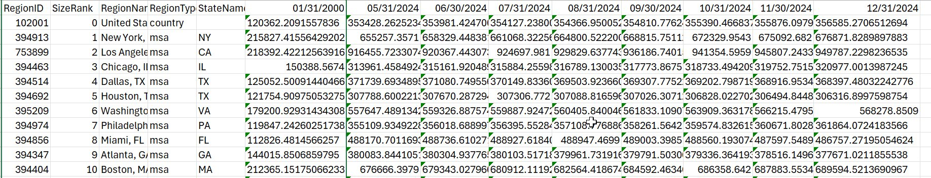
Zillow Home Value Index
ZHVI contains a measure of the typical home value and market changes across a given region and housing type. It reflects the typical value for homes in the 35th to 65th percentile range.
Source : https://www.zillow.com/research/data/
It contains attributes as below for 900 regions:
Region Id
Region Name
State Name
Median House Price monthly starting from 2000

Slide 16
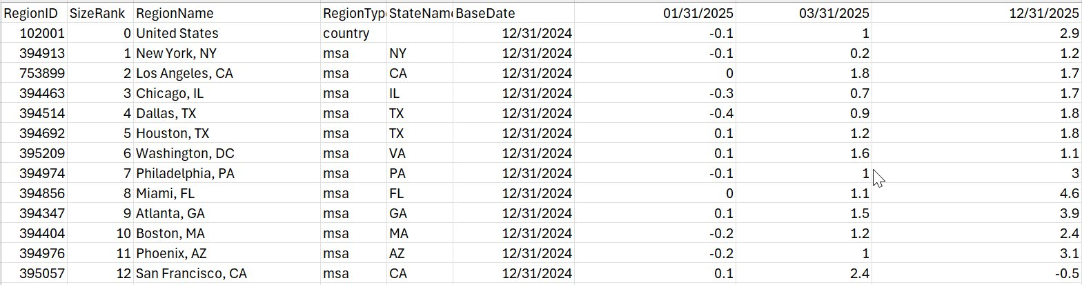
Zillow Home Value Forecast
ZHVF A month-ahead, quarter-ahead and year-ahead forecast of the Zillow Home Value Index (ZHVI). ZHVF is created using the all homes, mid-tier cut of ZHVI and is available both raw and smoothed, seasonally adjusted.
Source : https://www.zillow.com/research/data/
It contains attributes as below :
Region Id
Region Name
State Name
Base Date
Next Quarter Forecast
Year End Forecast.

Slide 17
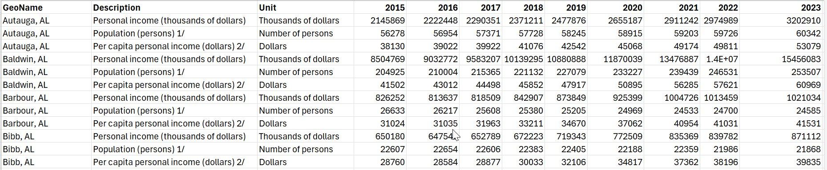
US Bureau of Economic Analysis
BEA is a division of the U.S. Department of Commerce that provides important economic data, such as GDP, personal income, and other key economic indicators.
Source : BEA Data Table
It contains attributes as below :
Geo Name
Description
Unit
Yearly Volume

Slide 18
Literature Review
Housing Price Prediction Using Machine Learning Algorithms in COVID-19 Times
Authors: Raul-Tomas Mora-Garcia, Maria-Francisca Cespedes-Lopez, V. Raul Perez-Sanchez Published in: Land Journal, 2022
Objective:
Identify the best machine learning (ML) models for predicting house prices.
Assess the impact of COVID-19 on real estate prices in Alicante, Spain.
Methodology:
Data Sources:
Real estate listings (prices, property features, amenities).
Georeferenced data integrating:
Cadastral records (property age, floor area, density).
Socio-economic indicators (income levels, population trends).
Satellite imagery (vegetation index, proximity to coast/parks).
Machine Learning Models Applied:
Boosting algorithms: Gradient Boosting, XGBoost, LightGBM.
Bagging algorithms: Random Forest, Extra-Trees.
Baseline model: Linear Regression.
Evaluation Criteria: Model accuracy, overfitting, and feature importance.
https://www.mdpi.com/2073-445X/11/11/2100

Slide 19
Key Findings, Factors, and Conclusion
Key Findings
Machine learning models significantly outperformed traditional regression.
Boosting models (Gradient Boosting, XGBoost, LightGBM) had the highest accuracy.
COVID-19 shifted housing demand toward less populated, suburban, and coastal areas.
Factors Affecting Housing Prices
Property Characteristics – Size, number of rooms, available amenities (pool, elevator).
Building & Neighborhood Features – Age, density, local income levels.
Location & Environment (Georeferenced Data)
Cadastral Records: Property age, floor area ratio (FAR), and structural attributes.
Socio-Economic Data: Household income, population distribution, and foreign ownership.
Satellite Imagery:
NDVI (Green Index): More greenery = higher property values.
Proximity to coast & parks: Coastal and green-rich areas had higher demand.
Market Conditions – Mortgage rates, government policies.
COVID-19 Impact – Increased demand for larger, more isolated homes.
Conclusion
Boosting ML models are the most effective for house price prediction.
Georeferenced data improves accuracy by integrating location-based factors.
COVID-19 significantly impacted buyer preferences, favoring suburban and coastal areas.
This research provides valuable insights for real estate investors, urban planners, and policymakers.

Slide 20
Literature Survey 2
Topic : Framework for predicting Optimal Price and Time to sell home.
Source : https://scholar.smu.edu/datasciencereview/vol6/iss2/16/
Executive Summary: Research aimed at optimizing the selling price and timing for homeowners using the NOVA Home Price dataset and machine learning models, including linear regression, random forest, and XGBoost.
Key Factors Influencing House Prices: Macroeconomic Trends: Inflation impacts housing material costs and market prices, diminishing buying power.
Housing Inventory: Limited availability drives up prices, especially noted during economic downturns like the COVID-19 pandemic.
Home Features: Quality of appliances, square footage, and proximity to amenities significantly affect property values.
Strategies to Address Housing Crisis: Increase Housing Supply: Encourage construction, especially affordable and multifamily units.
Economic Adjustments: Implement policies that stabilize inflation and interest rates to maintain affordability.
Technology Integration: Utilize advanced predictive models to empower homeowners with strategic selling insights.

Slide 21
Literature Survey 3
Topic : The State of the Nation’s Housing 2024.
Source : Harvard_JCHS_The_State_of_the_Nations_Housing_2024.pdf
Executive Summary: Both homeowners and renters are struggling with high housing costs. On the for-sale side, millions of potential homebuyers have been priced out of the market by elevated home prices and interest rates. Homeowner cost burdens are also on the rise, driven by growing taxes and insurance costs. For renters, the number with cost burdens has hit an all-time high as rents have escalated. While single-family construction is accelerating and a surge of new multifamily rental units is slowing rent growth, any gains in affordability are likely to be limited by robust household growth, ongoing development constraints, and high construction costs. All stakeholders must work together to address the affordability crisis and many related urgent housing challenges, including the inadequate housing safety net, the record number of people experiencing homelessness, and the growing threat of climate change.
Key Factors Influencing House Prices: Based on the Harvard Joint Center for Housing Studies (JCHS) report, several factors impact house prices, including:
•Construction Costs: Construction Costs remain elevated after Pandemic-Era Surges.
•Cost Burdens : Cost Burdens hit record high for renters while also rising for Home Owners.
•Interest Rates: High mortgage rates limit affordability and reduce home sales.
•Supply & Demand: Limited housing inventory drives price increases.
•Demographics: Growing millennial and Gen Z households increase demand.
•Immigration : Ballooning Immigration Population peaked at 3.3 million in 2023
•Single VS Multi Family: Single Family Construction is accelerating while multifamily Development declines.
•Economic Conditions: Wage growth and inflation affect purchasing power.
Address Gaps for House Crisis : Below are the factors that can help to address gaps for House Crisis.
•Increasing Housing Supply : Encouraging new construction, particularly for affordable and multifamily housing
•Regulatory Reforms : Reducing zoning restrictions and streamlining approval processes
•Financial Assistance : Expanding rental assistance such as down payment aid and low-interest mortgage products.
•Addressing Homelessness : Strengthening federal, state, and local programs to provide shelter and long-term housing for those experiencing homelessness. Promote Equitable access close racial homeownership gaps.
•Climate Resilience & Energy Efficiency : Investing in sustainable housing solutions and retrofitting homes for energy efficiency while minimizing cost burdens.

Slide 22
Literature Survey 4
Topic : House Price Prediction using Random Forest Machine Learning Technique
Source: Procedia Computer Science vol 199 (2022)
Executive Summary:
Machine learning (Random Forest) applied to house price prediction.
Uses UCI Boston Housing Dataset with 506 entries & 14 features.
Model achieved ±5% prediction error.
Key Factors Influencing House Prices:
Location, infrastructure, economic conditions, property attributes.
Environmental factors and demand-supply dynamics.
Methodology:
Data pre-processing (scaling, normalization, feature selection).
Model training using Random Forest (70% train, 30% test).
Performance evaluation with MAE, RMSE, and R².
Results:
High correlation between predicted and actual prices.
Effective for real estate decision-making.
Future Improvements:
- Use of deep learning (Neural Networks, Gradient Boosting).
- Incorporating socio-economic & real-time data for better accuracy.

